Slide 1
2026.3.3
Group meeting

Slide 2
Recent Work Summary
Objective
Key question:
Is the performance gain from better optimization or better model structure?
Strategy
baseline groups:
Same structure, stronger optimizers
Structure ablation
Pure data-driven (MLP)

Slide 3
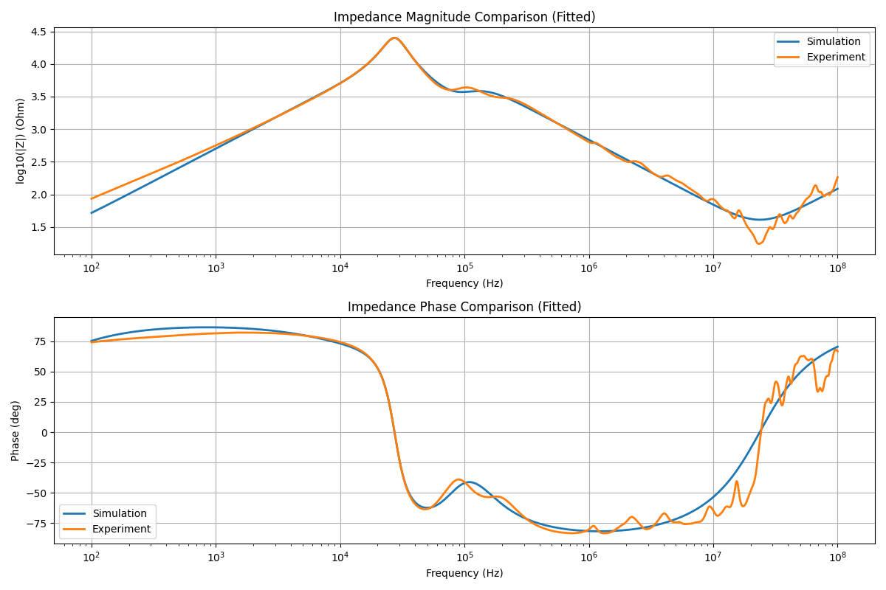
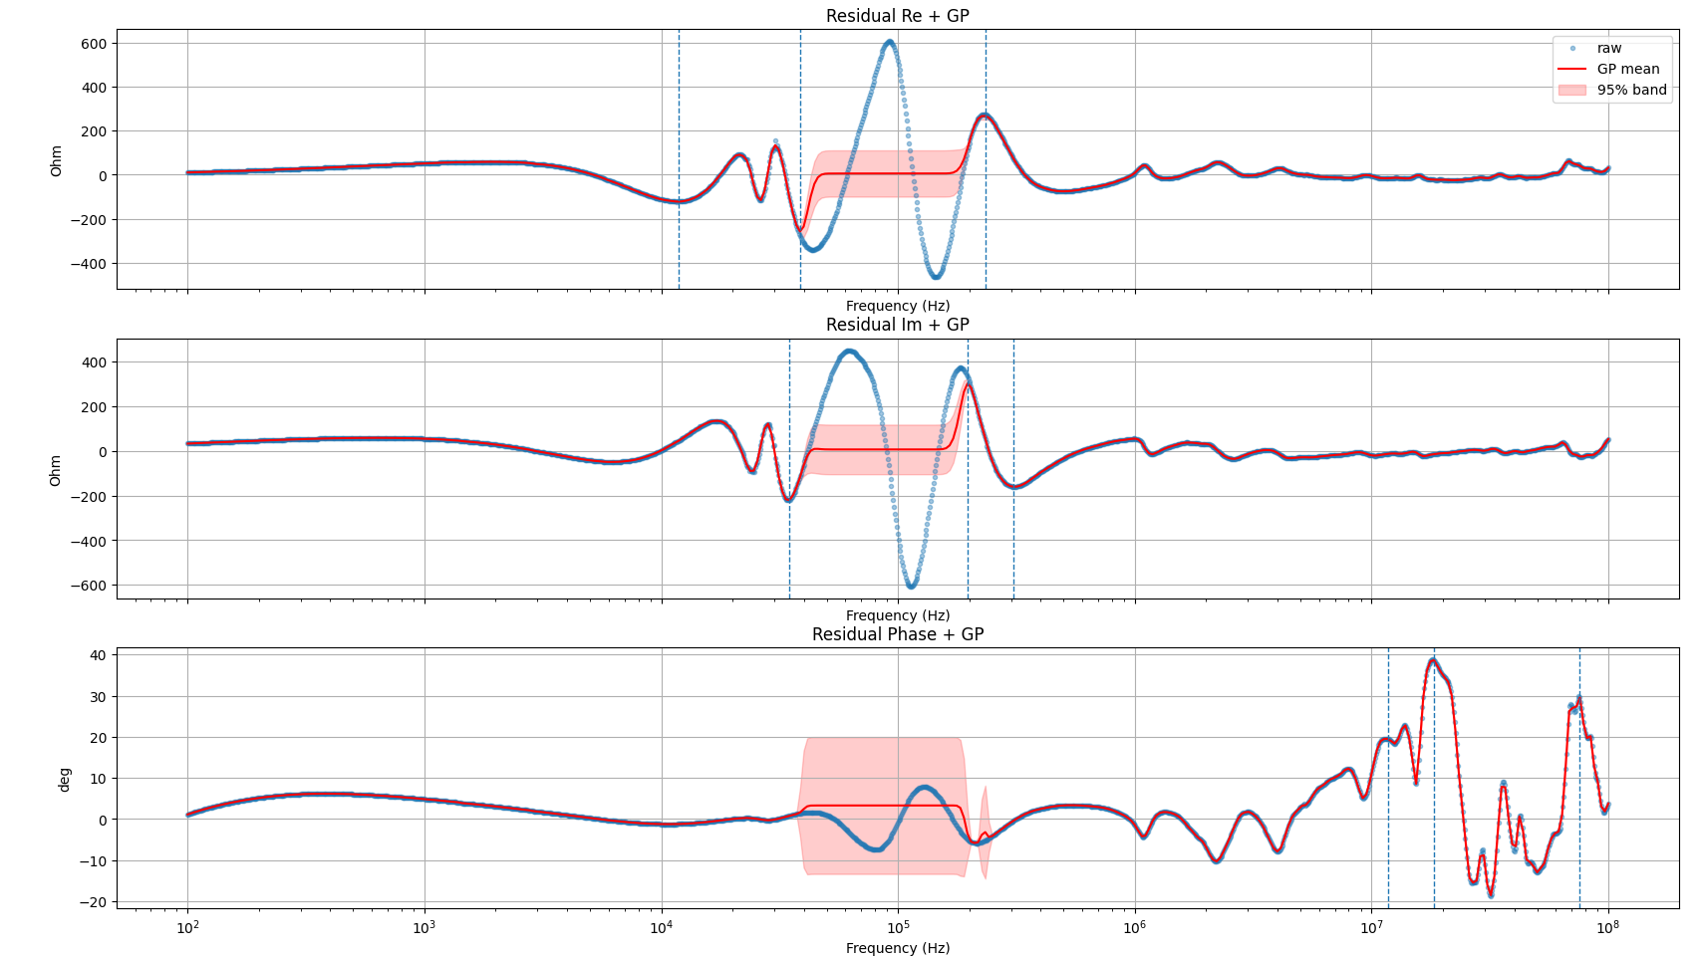
Current Method
Core Algorithm: Two-stage optimization (global + local) (differential_evolution → least_squares), with multiple starting point selection.
Objective Function: Using the Re/Im residual of complex impedance (instead of log|Z|+phase), and introducing frequency weights (compute_freq_weights), scale normalization (MAD/STD), and robust loss (soft_l1/huber).
A"more robust fit" version, which focuses on improving global search capabilities, outlier resistance, and diagnosing model defects from residual structure.

Slide 4
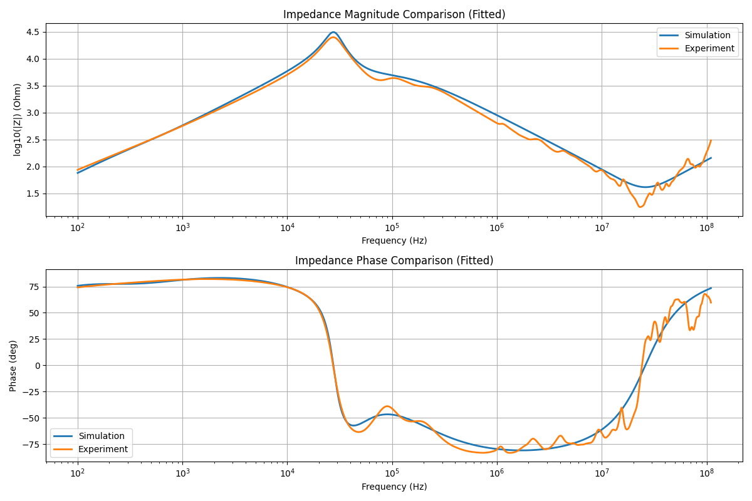
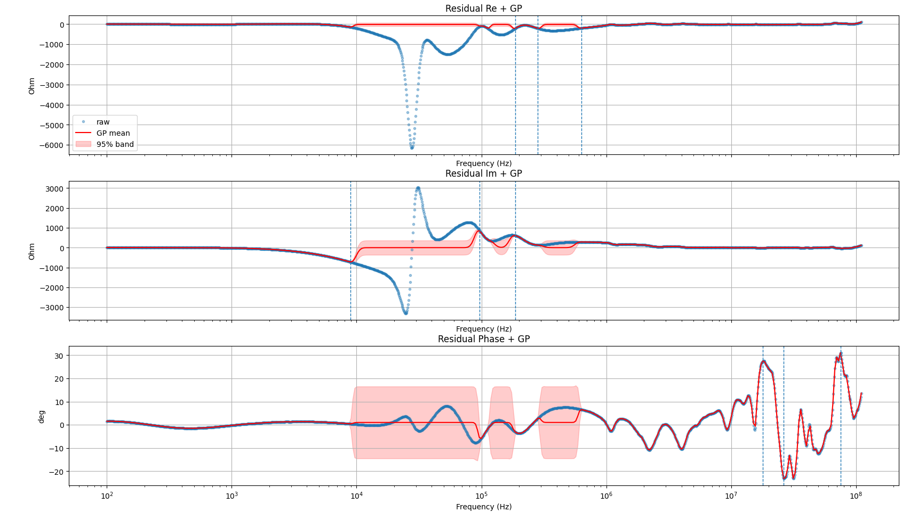
Initial version
Core Algorithm: Single-step local optimization (scipy.optimize.least_squares).
Objective Function: Log10(|Z|) concatenated with the phase residual (phase difference using phase_diff_deg), scaled with fixed weights W_LOGMAG / W_PHASE.
The simplest "local least squares" baseline, fast, but prone to getting trapped in local optima and lacks global search or uncertainty estimation.

Slide 5
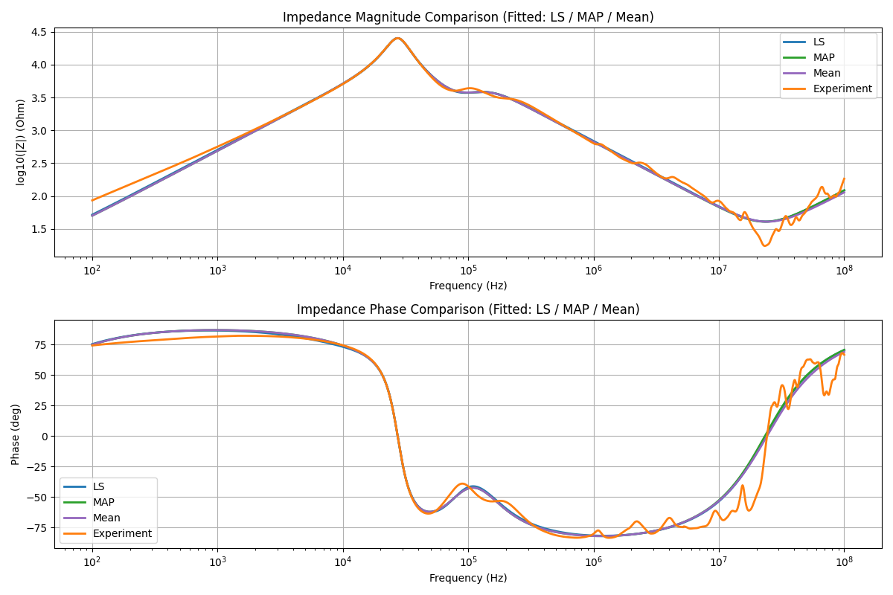
NUTS
Core Algorithm: Based on CurVer, Bayesian inference (NUTS in PyMC) is added. First, global and local point estimates are obtained, then NUTS sampling is used to obtain the posterior distribution.
Objective Function: Still based on Re/Im residuals, but expressed using a probabilistic model (pm.Normal observation residuals), generating MAP and posterior mean.
A version with "uncertainty estimation" can output parameter distributions and confidence intervals, at the cost of a significant increase in computation.

Slide 6
GA
Core Algorithm: Based on CurVer, Bayesian inference (NUTS in PyMC) is added. First, global and local point estimates are obtained, then NUTS sampling is used to obtain the posterior distribution.
Objective Function: Still based on Re/Im residuals, but expressed using a probabilistic model (pm.Normal observation residuals), generating MAP and posterior mean.
A version with "uncertainty estimation" can output parameter distributions and confidence intervals, at the cost of a significant increase in computation.

Slide 7
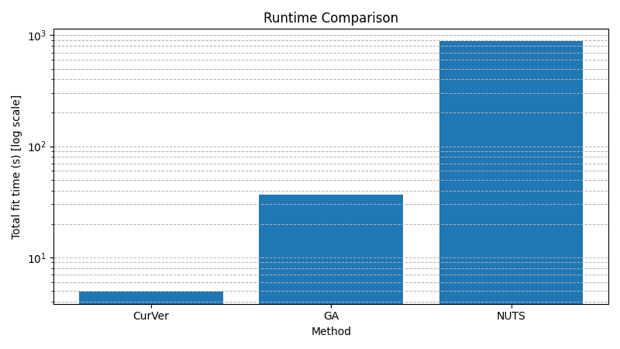
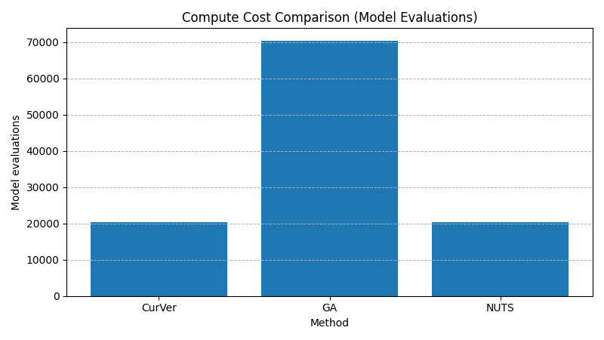
Algorithm Comparison
Same accuracy across all methods:
SSE_raw ≈ 5.45×10^7, RMSE_raw = 130.917 for CurVer / GA / NUTS;
AIC_raw / BIC_raw essentially identical;
GP residual peak frequencies identical (Re/Im/Phase) → converged to the same optimum
Compute cost differs dramatically:
CurVer: T_fit_total = 4.943 s, model_eval = 20,399;
GA: T_fit_total = 36.394 s (~7.4× slower), model_eval = 70,286 (~3.4× more evals);
NUTS: T_fit_total = 878.821 s (~178× slower), dominated by T_nuts = 867.419 s
Conclusion: Genetic Algorithm and Bayesian sampling (NUTS) do not improve fit quality under this model structure.

Slide 8
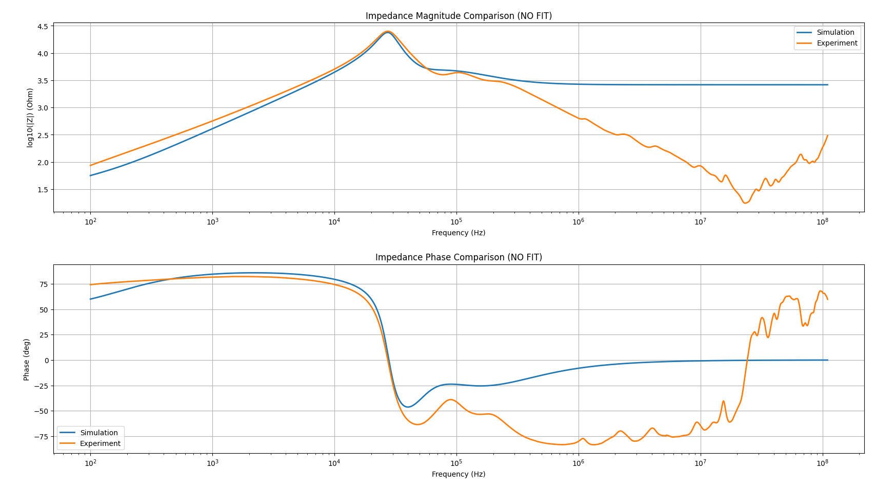
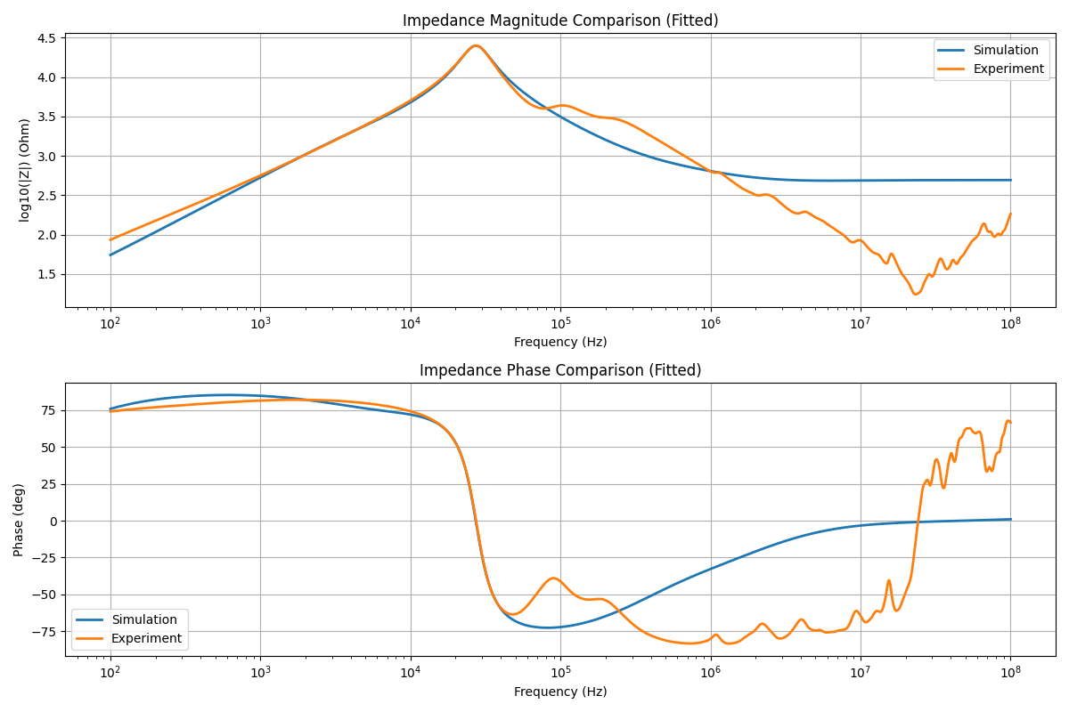
Structural ablation
Pure analytical method
Pure Fit Method
Performance very poor; no further comparison needed

Slide 9
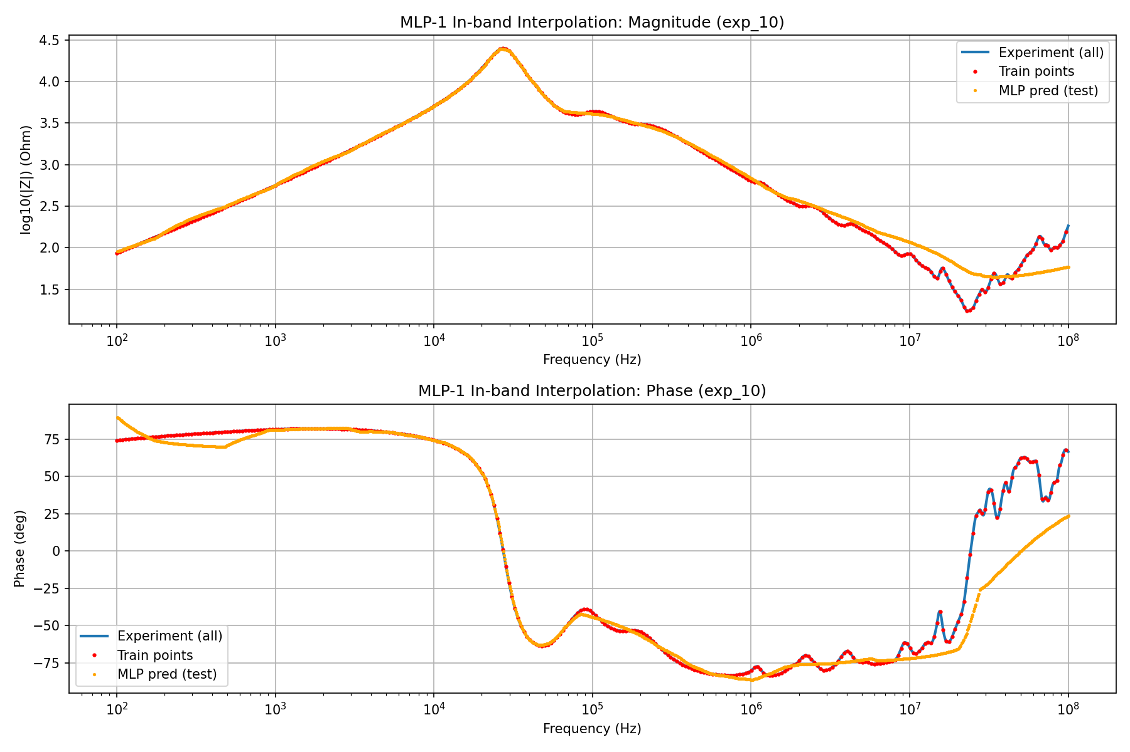
MLP-1: In-band Interpolation
Setup
Train on sparse points across entire band
Test on remaining points
Result
✔ Good fit in low/mid frequency
✘ High-frequency details are smoothed
Insight
MLP learns global trend, but suppresses high-curvature structures.

Slide 10
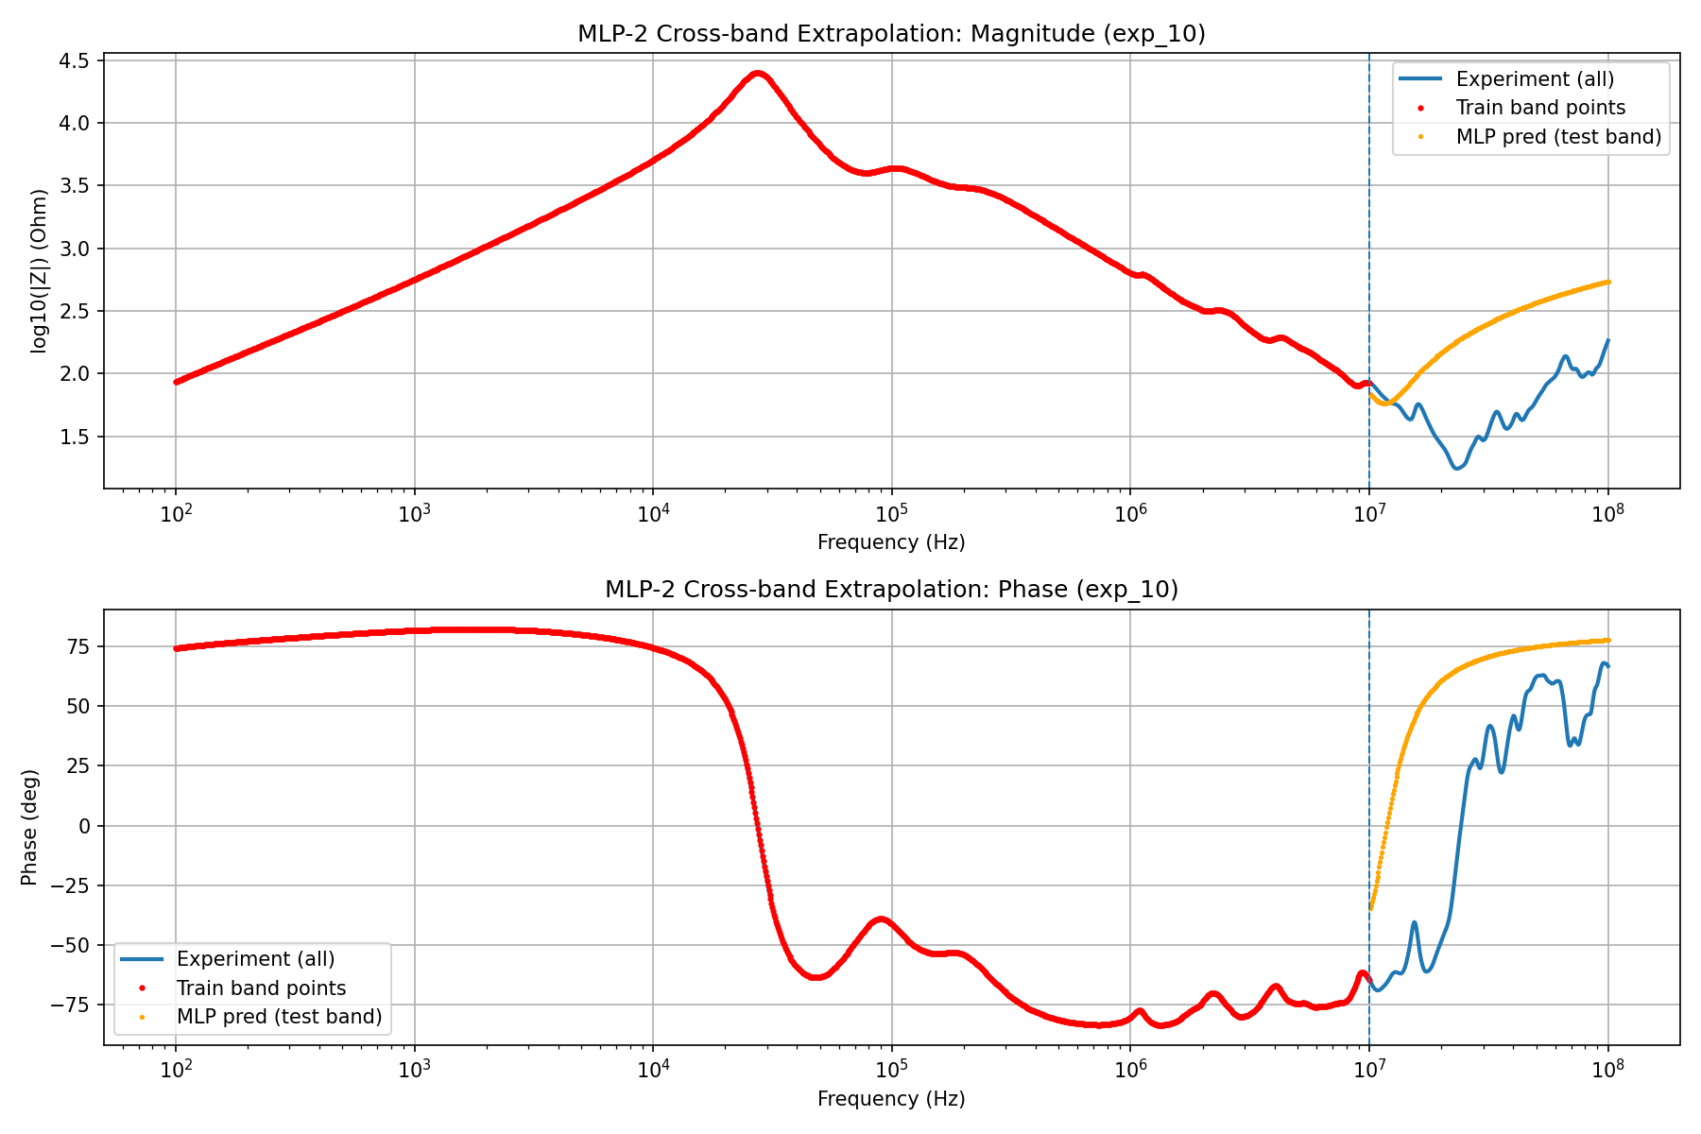
MLP-2: Cross-band Extrapolation
Setup
Train: 10 Hz – 1e7 Hz
Test: 1e7 – 1e8 Hz
Observation
✔ Phase trend (upturn) extrapolated correctly
✘ High-frequency resonant structures not recovered
✘ Magnitude dip underestimated
Interpretation
MLP performs smooth extrapolation
but cannot generate new high-frequency dynamics.

Slide 11
Future Work
1️⃣ Reproduce 1–2 SOTA Approaches
2️⃣ Experimental Validation of Model Interpretability
Approach A — Cross-Power Prediction
Fit the model using Dataset 1 (Power Level 1)
Only adjust parameters theoretically dependent on power
Predict Dataset 2 (Power Level 2)
Evaluate predictive consistency
→ Tests whether parameters retain physical meaning
Approach B — Parameter Sensitivity Analysis
Fit independently on Dataset 1 and Dataset 2
Analyze parameter variations vs. power level
Check consistency with expected physical mechanisms
→ If parameter trends align with physical behavior,
the model demonstrates stronger interpretability.

